Slide 1

Handwriting Recognition for Smartwatches using various machine learning models
By : Sai Prakhya
Role: Data Scientist

Slide 2
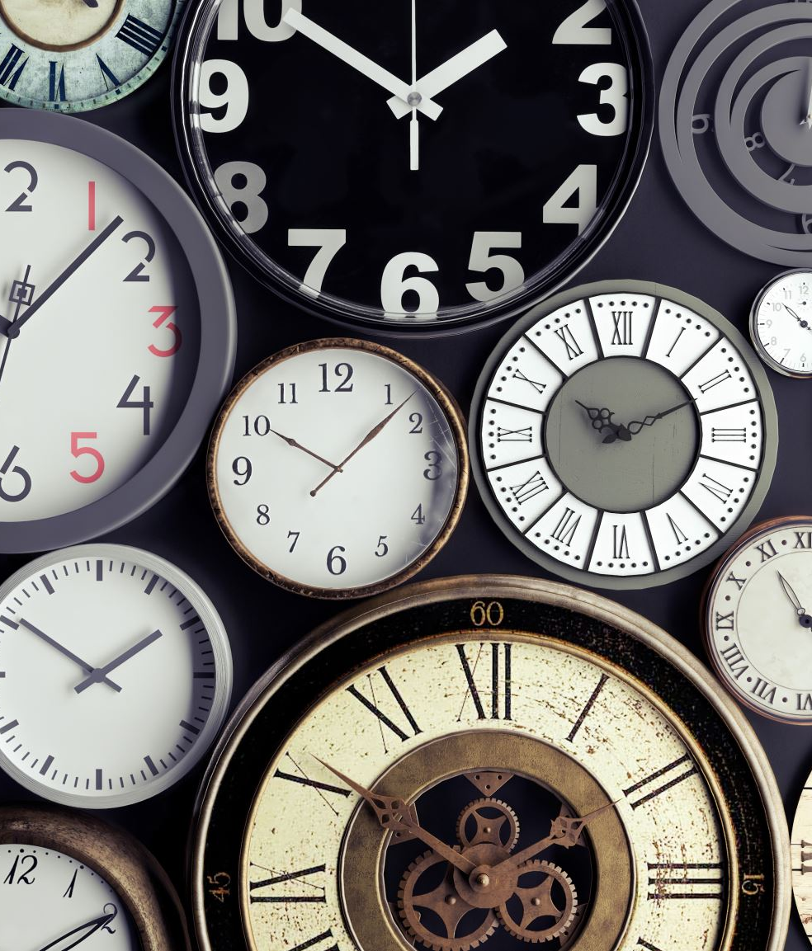
Handwriting Recognition in Smartwatches
This technology implements machine learning models to digitize handwritten notes on smartwatches, enhancing productivity and data management. Four key models are employed: Traditional Naive Bayes for quick, basic recognition; Gaussian Naive Bayes for improved style handling; Multivariate Gaussian Naive Bayes for enhanced complexity recognition; and K-Nearest Neighbors for high accuracy across diverse styles. The implementation strategy involves adaptive model selection, balancing on-device and cloud processing, continuous learning, and battery optimization. Users benefit from improved productivity, enhanced accessibility, personalization, and versatility. Challenges such as limited processing power, battery life concerns, small display size, and varied handwriting styles are addressed through hardware optimization, adaptive model selection, intuitive UI design, and use of model ensembles. Future enhancements may include AI assistant integration, multilingual support, gesture recognition, and handwriting-based authentication.

Slide 3
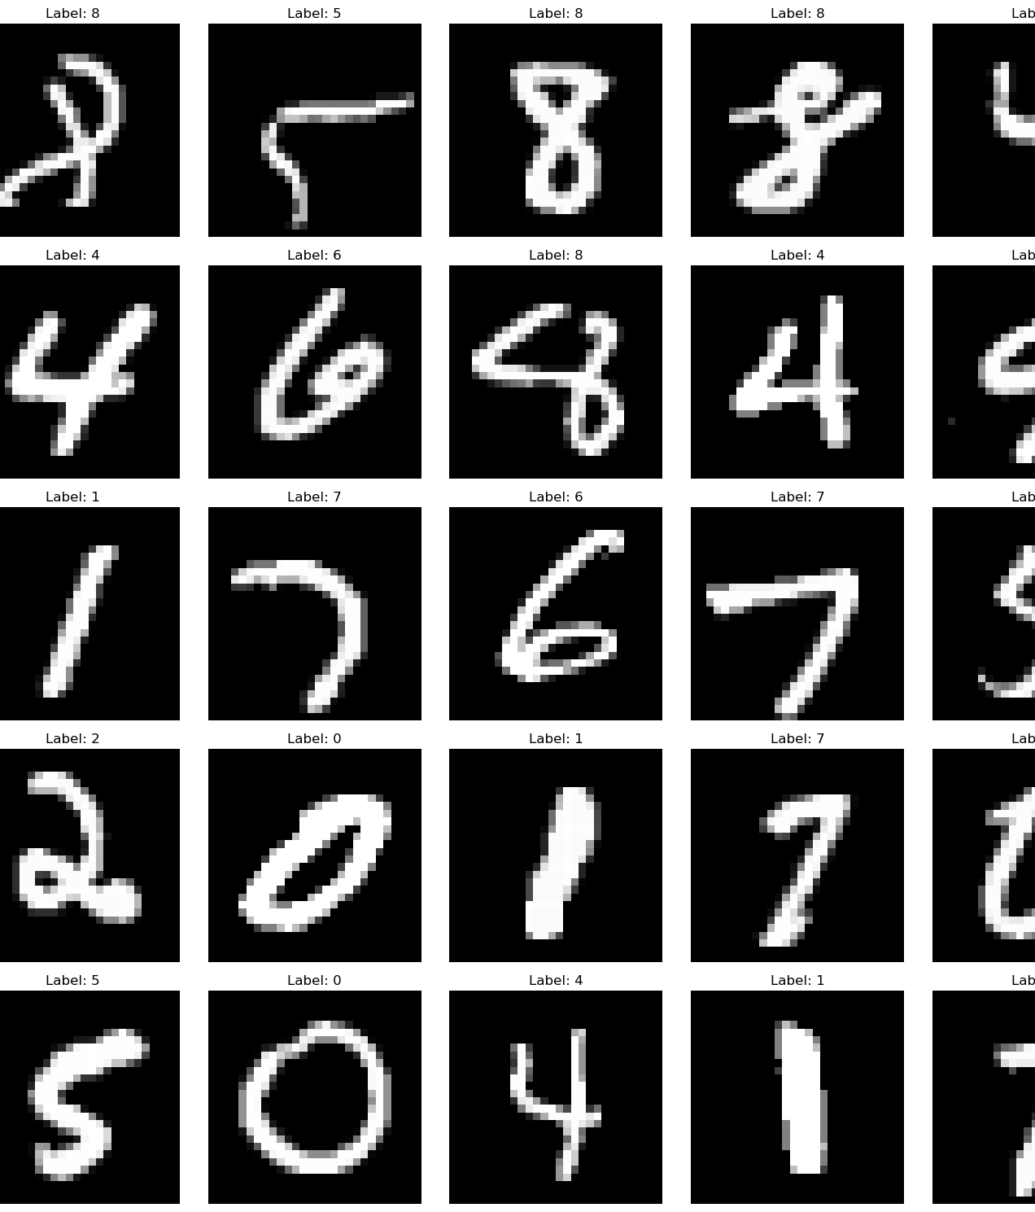
Project Overview & MNIST Dataset
Objective:
Compare machine learning models for handwritten digit recognition
MNIST Dataset:
70,000 images of handwritten digits (0-9)
28x28 pixel grayscale images
60,000 training images, 10,000 test images
Key Challenges:
Varied handwriting styles
Similar-looking digits (e.g., 4 vs 9, 3 vs 5)

Slide 4
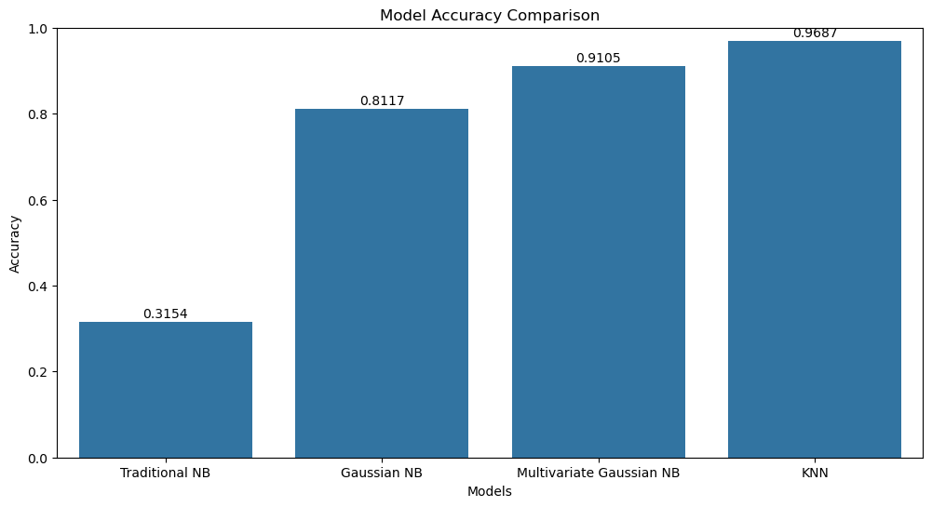
Models & Evaluation
Models Implemented:
Traditional Naive Bayes
Gaussian Naive Bayes
Multivariate Gaussian Naive Bayes
K-Nearest Neighbors (KNN)
Evaluation Metrics:
Accuracy
Precision
Recall
F1-score

Slide 5
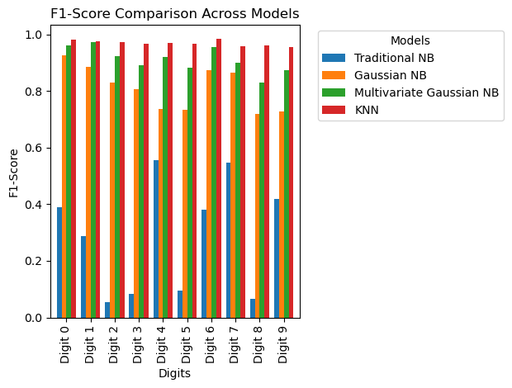
F1-Score Comparison Across Models
Objective: Compare the F1-scores of four different models across the digits (0-9).
Models Compared:
Traditional Naive Bayes (NB) (Blue)
Gaussian Naive Bayes (NB) (Orange)
Multivariate Gaussian NB (Green)
K-Nearest Neighbors (KNN) (Red)
Key Observations:
KNN consistently outperforms the other models across most digits, achieving near-perfect F1-scores.
Gaussian NB performs better than the Traditional NB and Multivariate Gaussian NB for most digits.
Digits 3 and 5 show lower F1-scores across all models, indicating more difficulty in classification.
Traditional NB shows the least performance, particularly struggling with Digit 0.

Slide 6
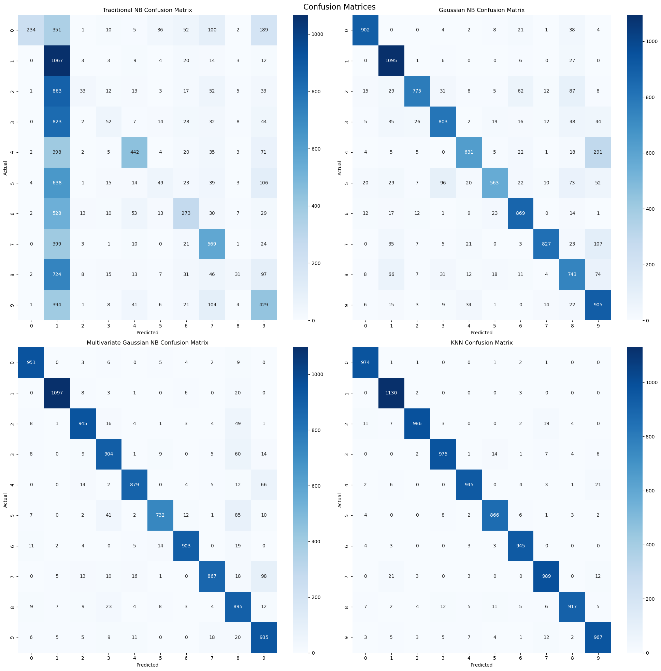
Confusion Matrix Comparison Across Models
Objective: Analyze the confusion matrices of four different models to understand their classification performance on the MNIST dataset.
Models Evaluated:
Top Left: Traditional Naive Bayes (NB)
Top Right: Gaussian Naive Bayes (NB)
Bottom Left: Multivariate Gaussian NB
Bottom Right: K-Nearest Neighbors (KNN)
Key Observations:
Traditional NB:
Struggles significantly with digits 3 and 5, leading to high misclassification rates.
Gaussian NB:
Improved classification accuracy compared to Traditional NB, especially with digit 4.
Multivariate Gaussian NB:
Moderate performance with some misclassifications, particularly with digits 3 and 7.
KNN:
Best overall performance, with very few misclassifications. Most diagonal elements (correct predictions) are darker, indicating higher accuracy.
General Insight:
KNN model consistently shows the most accurate classification across digits, followed by Gaussian NB. Traditional NB underperforms, highlighting its limitations for this dataset.

Slide 7
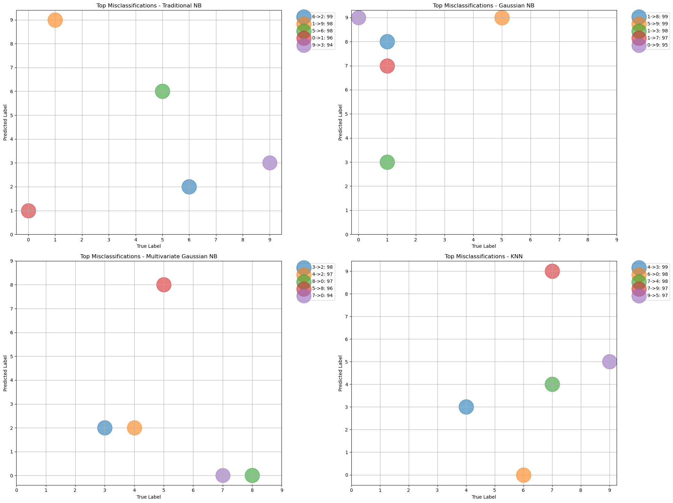
Top Misclassifications Across Models
Objective: Visualize the top misclassifications made by each model on the MNIST dataset.
Models Analyzed:
Top Left: Traditional Naive Bayes (NB)
Top Right: Gaussian Naive Bayes (NB)
Bottom Left: Multivariate Gaussian NB
Bottom Right: K-Nearest Neighbors (KNN)
Key Observations:
Traditional NB:
Significant misclassification of digit 0 as 6, and digit 1 as 8.
Gaussian NB:
Most frequent misclassification involves digit 3 being predicted as 8.
Multivariate Gaussian NB:
Misclassifies digit 3 as 2 and digit 8 as 3, showing some pattern similarities to Gaussian NB.
KNN:
Fewer misclassifications overall, but notable errors include digit 4 being predicted as 9 and digit 7 as 2.
General Insight:
Misclassification patterns vary significantly across models, with KNN having the most distinct and minimal misclassification pattern, reaffirming its superior performance in earlier analyses.

Slide 8
Key Findings & Future Directions
Key Findings:
Model performance improved with increased complexity (Traditional NB < Gaussian NB < Multivariate Gaussian NB < KNN)
KNN showed the best overall performance (96.87% accuracy)
All models struggled with visually similar digits (e.g., 4 vs 9, 3 vs 5)
Capturing feature correlations significantly improved performance (Multivariate Gaussian NB vs Gaussian NB)
Challenges Faced:
Balancing model complexity with interpretability
Handling high-dimensional image data
Computational demands, especially for KNN
Future Directions:
Explore ensemble methods to combine strengths of different models
Investigate deep learning approaches (e.g., Convolutional Neural Networks)
Experiment with feature engineering to improve simpler models
Conduct more in-depth analysis of misclassifications to guide model improvements

Slide 9

Conclusion
Project Summary:
Successfully compared four machine learning models for MNIST digit recognition
Demonstrated the evolution of model complexity and its impact on performance
Key Takeaways:
Model choice significantly affects recognition accuracy
Considering data characteristics (e.g., feature correlations) is crucial
Trade-offs exist between model complexity, performance, and interpretability
Implications:
Insights gained can inform approach to similar image classification tasks
Importance of tailoring model choice to specific dataset characteristics
Final Thought:
MNIST remains a valuable benchmark for testing and comparing ML algorithms
"Thank you for your attention. Any questions?"

